Slide 1



Tokens and Embeddings
Chapter 2

Slide 2


Tokens and Embeddings
Language models deal with text in small chunks called tokens. For the language model to compute language, it needs to turn tokens into numeric representations called embeddings.

Slide 3
Tokenizer
A tokenizer breaks down text into words or parts of words before the model processes the text. It does so according to a specific method and training procedure.
Notes:
Before the prompt is presented to the language model, however, it first has to go through a tokenizer that breaks it into pieces. You can find an example showing the
tokenizer of GPT-4 on the OpenAI Platform. If we feed it the input text, it shows the output in Figure 2-3, where each token is shown in a different color.

Slide 4
Word tokens
One challenge with word tokenization is that the tokenizer may be unable to deal with new words that enter the dataset after the tokenizer was trained. This also results in a vocabulary that has a lot of tokens with minimal differences between them (e.g., apology, apologize, apologetic, apologist). This latter challenge is resolved by subword tokenization as it has a token for apolog, and then suffix tokens (e.g., -y, -ize, -etic, -ist) that are common with many other tokens, resulting in a more expressive vocabulary.
Notes:
This approach was common with earlier methods like word2vec but is being used less and less in NLP. Its usefulness, however, led it to be used outside of NLP for use cases such as recommendation systems.

Slide 5
Subword tokens
This method contains full and partial words. In addition to the vocabulary expressivity mentioned earlier, another benefit of the approach is its ability to represent new words by breaking down the new token into smaller characters, which tend to be a part of the vocabulary.

Slide 6
Character tokens
This is another method that can deal successfully with new words because it has the raw letters to fall back on. While that makes the representation easier to tokenize, it makes the modeling more difficult. Where a model with subword tokenization can represent “play” as one token, a model using character-level tokens needs to model the information to spell out “p-l-a-y” in addition to modeling the rest of the sequence.
Notes:
Subword tokens present an advantage over character tokens in the ability to fit more text within the limited context length of a Transformer model. So with a model with a context length of 1,024, you may be able to fit about three times as much text using subword tokenization than using character tokens (subword tokens often average three characters per token).

Slide 7
Byte tokens
One additional tokenization method breaks down tokens into the individual bytes that are used to represent unicode characters.

Slide 8
Tokenizer methods
There are multiple methods of tokenization that break down the text to different sizes of components (words, subwords, characters, and bytes).

Slide 9
Tokens to embeddings
A language model holds an embedding vector associated with each token in its tokenizer.

Slide 10
Creating Contextualized Word
A language model operates on raw, static embeddings as its input and produces contextual text embeddings.

Slide 11










TYPES OF AI
NARROW AI
GENERAL AI
SUPER AI
Narrow AI is designed to perform a specific task
General AI can perform any intellectual task that a human can
Super AI is hypothetical and would surpass human intelligence

Slide 12





HISTORY OF AI
The Dartmouth Conference, where the term "artificial intelligence" was first coined and AI was established as a field of research.
1956
The first AI system that could understand and respond to natural language was created by Terry Winograd, which marked a major step forward in natural language processing.
1974
IBM's Deep Blue defeated the world chess champion Garry Kasparov, demonstrating that machines could surpass human intelligence in specific domains.
1997
The emergence of deep learning led to breakthroughs in computer vision, speech recognition, and natural language processing.
2012

Slide 13



IN FINANCE
75%
12,000
50%
people said that AI has improved their decision-making process.
Morgan Chase used AI to analyze 12,000 commercial loan agreements in seconds
The use of AI in fraud detection has led to a 50% reduction in false positives

Slide 14








IN MANUFACTURING
Item 2
Item 3
12
10
8
6
4
2
0
2015
2016
2017
2018
2019
2020
2021

Slide 15








IN TRANSPORTATION
REDUCE 20% FUEL CONSUMPTION
REDUCE 30% MAINTENANCE COSTS
Self-driving trucks powered by AI have been shown to reduce fuel consumption by up to 20%, saving companies thousands of dollars per year.
AI-powered predictive maintenance can reduce maintenance costs by up to 30%, and increase vehicle reliability and uptime.

Slide 16






03
SOCIAL IMPLICATIONS
Explores the broader impact of AI beyond specific industries or applications. Considers ethical and societal implications such as job displacement, bias, privacy concerns, and potential impacts on democracy and human rights. Encourages a critical and thoughtful approach to AI development and deployment, taking into account the potential risks and benefits to individuals and society as a whole.

Slide 17




AI AND JOBS
JOBS AT HIGH RISK
JOBS AT SIGNIFICANT RISK
14%
32%

Slide 18



AI ETHICS
81%
People believe that companies should prioritize ethical considerations
63%
Were concerned about the ethical implications of the AI system

Slide 19
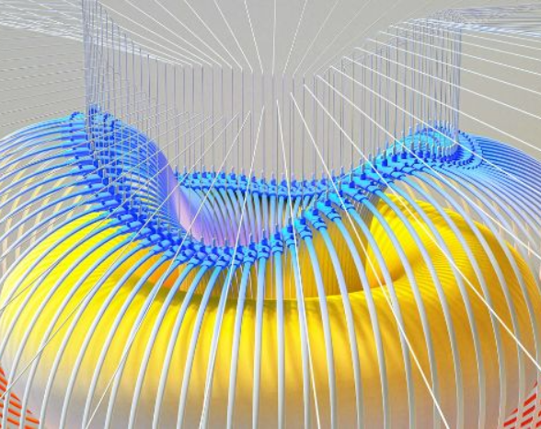

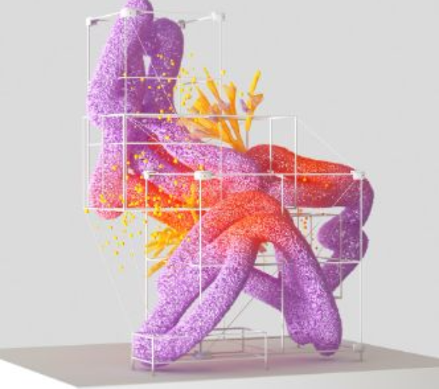

AI AND PRIVACY
A survey by Pew Research Center found that 64% of Americans are concerned about the way that companies are using their data, and 81% feel that they have little or no control over the data that companies collect about them.
20%
55%
The EU's GDPR includes provisions for ensuring that individuals have the right to access and control their personal data, including data that is processed using AI systems.

Slide 20



AI AND SOCIETY
Discusses the broader societal implications of AI, including its impact on job displacement, inequality, and social norms. This section aims to provide a comprehensive understanding of the ways in which AI is shaping our society and the challenges that need to be addressed.
04

Slide 21


THE RISE OF POWERFUL AI WILL BE EITHER THE BEST OR THE WORST THING EVER TO HAPPEN TO HUMANITY. WE DO NOT YET KNOW WHICH.
STEPHEN HAWKING

Slide 22








THANK YOU FOR
CHOOSING EATEMP
We offer free and high-quality slides templates for your presentations. We appreciate you choosing us and hope our templates have been helpful.
As a new website, we rely on your support to grow, so please help us by sharing our site with your friends and colleagues.
eatemp._
@eatemp
eatempofficial
@eatemp.official

